Slide 1
Inquiry in the classroom: Project based learning
Based upon the work of Kath Murdoch, The process of Action Learning, Cognitive Coachingsm
Meg Wheatley AND Leith!
Notes:
Introduce myself
Cognitive coaching texts
Action Learning frame…. think plan act reflect… within the Reflective teacher key points
Cognitive coaching key points
Meg Wheatley articles. Key points
You will notice each of these philosophies threaded through our work into the Research circle.
We need to emphasize the interconnections.
None of these philosophies is fore grounded…
Horace article
Recognize and state sources of information

Slide 2
Today:
What is happening?
What are we doing?
What am I doing?
Why?
Notes:
Introduction:
leith
Details on BB or white board for session

Slide 3
Norms
adopt a sense of responsibility in and for the group
attend to others and listen
cooperate in good faith
aim for consensus decision-making
confront problems respectfully
allow and give no put downs
accept where others are at
suspend judgments

Slide 4
Margaret Wheatley
Our work in the world is to foster critical connections.
Networks make it possible for people to find others engaged in similar work.
Where people share their common work, they realize that there is great benefit to being in relationship.
Communities of practice where people can exchange ideas and resources provide nourishment for them to share their practices experiences and dreams

Slide 5
Margaret Wheatley
Everyone can engage in conversation where people respectfully take turns to listen...to seek understanding...
to help the other person, not just themselves…to think about things they’ve done and to think about what they might do about it...

Slide 6
Schlecty: ‘Working on the work’
The primary role of teachers is to create engaging work for students and guiding them to those sources of instruction that they need to successfully to do this work
Differences in the level and type of engagement affect directly the effort that a student will expend on a school related task.
Effort affects learning outcomes at least as much as does intellectual ability
The level and type of engagement will vary depending on the qualities that teachers build into the work that they provide for their students
Notes:
Schlecty WOW
6 groups of 3 to discuss each point
Give us 3 ideas when summing up each point
Each group member gives 1 idea

Slide 7
Therefore:
Teachers can directly affect student learning through the invention of work that has those qualities that are most engaging for students.
Notes:
Schlecty

Slide 8
‘Do not feed the birds.
If you do feed the birds , do not feed them bread.’

Slide 10
Do not feed the birds

Slide 15
How do we help our students make sense of the world they are in …
What do we need to do to help them with this?
Connect them locally to their country and community and wider… how?
Inquiry works!!
We have no choice about this if the students we are working with are to make sense of the 21st century

Slide 16
THROUGH:
An understanding of questioning
Mind maps,
Structured overviews,
Story maps
Highlighting key words and phrases
Breaking tasks into ‘chunks’
What is coming?
Prediction before reading.
‘Think aloud’ reading comprehension strategies
Using varied pathways to assist comprehension:
ICT , Video/ You tube, Assistive technology.
Illustrations to indicate comprehension…… Posters, charts, Procedures, Wepublish app, Book Creator etc.,
Notes:
Page 35 More? What do you do? What do you think you might try? Talking with each other

Slide 17
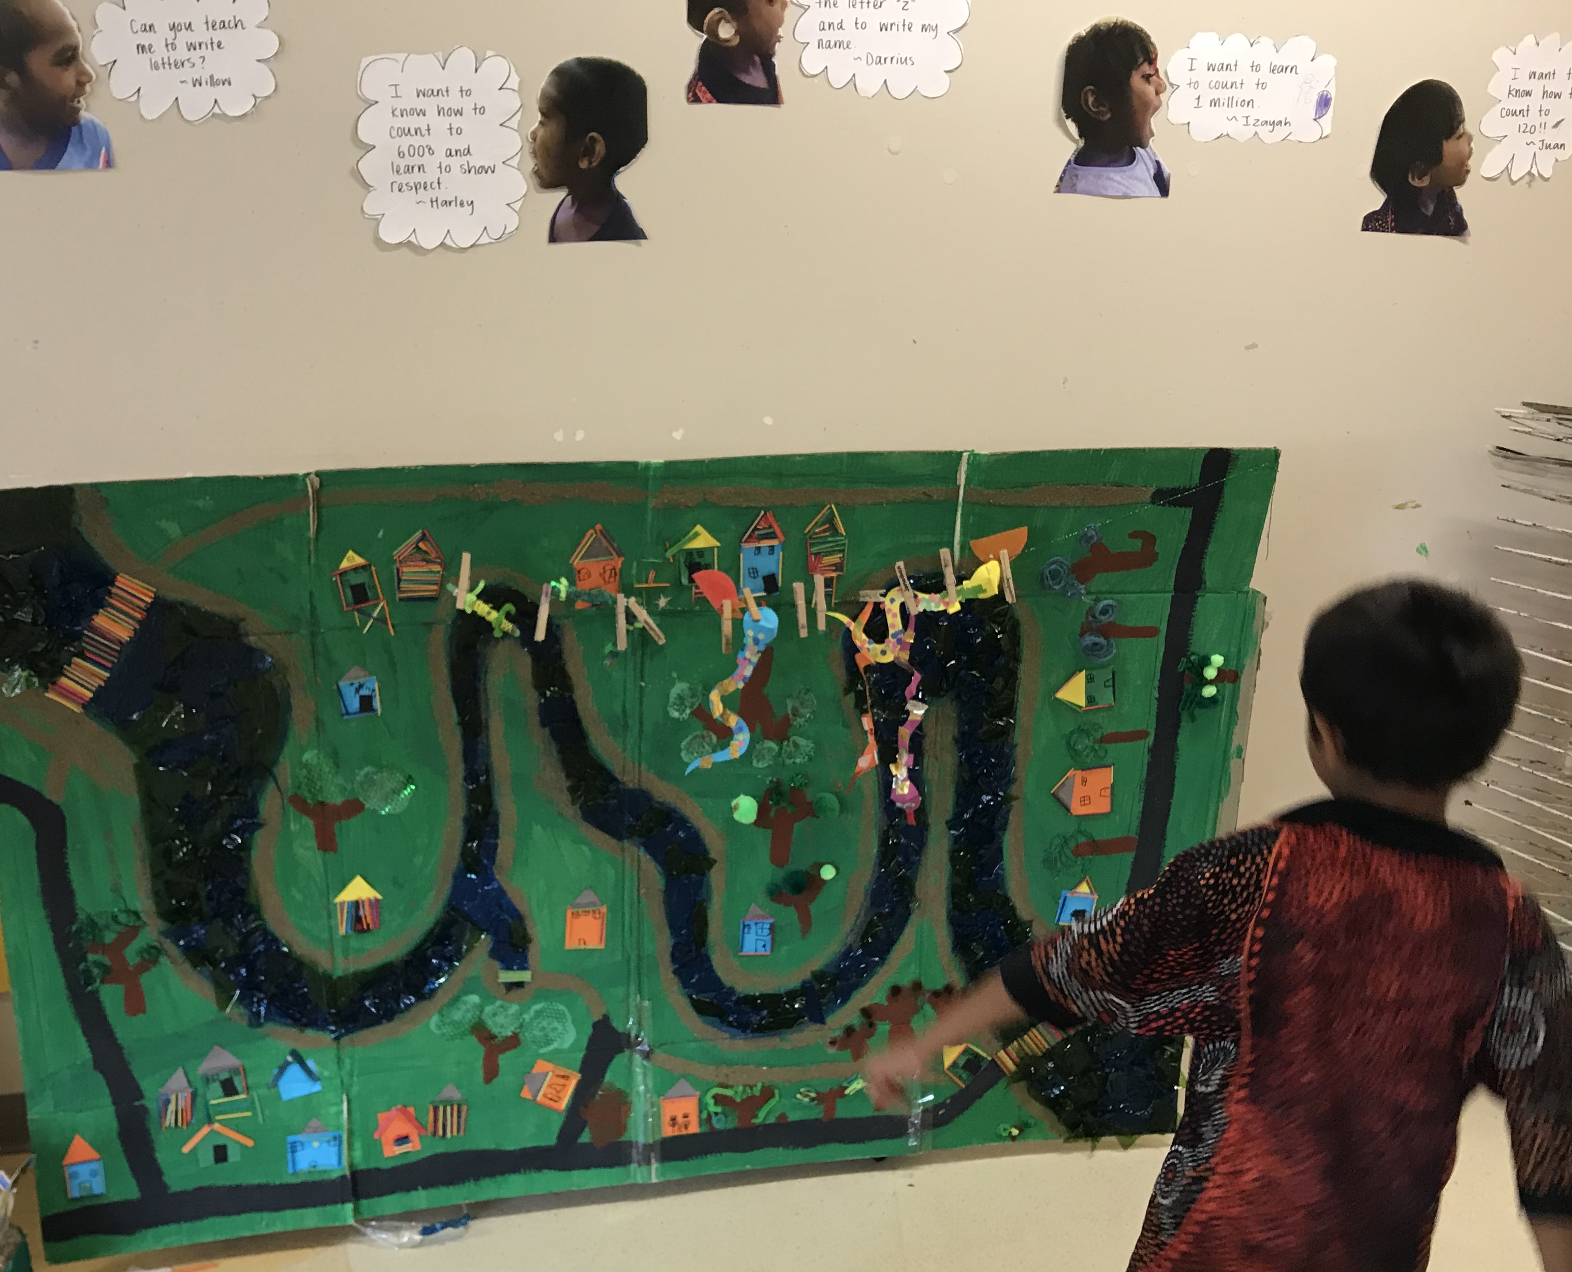

Slide 18
BLANK
Level 1. Matching perception processes. Find one like this… Show me what you heard/ saw…. what did you touch ?
Level 2. Selective analysis
Find one that can…What things? Tell me it’s….how are these different?
Level 3.Re ordering perception. Find one to use with this….Do this then this make these into What else?
Level 4. Reasoning and perception. Where will?
What will happen if? Why wouldn’t…What else could you do? Why is this called ?

Slide 19
Have you thought of ??
Notes:
Feedback: A phrase..

Slide 20
Start local…. go global
How connected is this school to the local environment?
What do the students know about this local world?
What do you want them to know?
How can you strengthen their connection to their world…especially at this moment when the world is in turmoil.
Connecting to the world outside our heads is the way we keep mentally healthy!
So, how connected are your students?
How connected are you?

Slide 21
Mind map your local community
Everything that you can think of that is connected to Brentwood school?
How?
Get into working groups of 8 across the years..
Have a K, PP, 1,2 ,3 ,4 ,5 and a year 6 teacher in your group.
Now…. Brainstorm everything that you can think of connected to Brentwood.
Everything!!

Slide 22
Brentwood
Group all of your ideas into piles or categories:
The lake
The birds
Vegetation
Wildlife
Shops
Community organizations
Streetscape etc., etc.,

Slide 23
Planning
Look at your current Curriculum planning documents…
Do any of these ideas resonate with your planning and YOU ???
Can you think about an inquiry question that connects to your curriculum and the Mind map ideas that your students would be keen to explore….just as a practice at an Inquiry?

Slide 24
Questioning
Asking questions:
Probing or inquiring
What might…
How might…
What will….
What’s the..
If you could…
In what ways
Notes:
Page 46 CCoaching
Marian Blank levels of questioning
Look at planning again review it adapt / change

Slide 25
Marian BLANK level 4 questions
What will happen if..... (predicting)
Why will that happen?(justifying a prediction)
Why would/ wouldn't… (justifying a decision)
What made you(identifying the cause of an event)
What could you do to solve this problem? (formulating a solution)
What could you use/ Why?(Selecting/explaining means to a goal)
How can you tell? (explaining an inference)
Notes:
CC Practice questions ….. Classroom context to pedagogy to deep held beliefs .. Levels 1 to 3, 4
Page 114/ 115

Slide 26
Questioning
What might your Level 4 inquiry question be?
Remember it needs to be a question that can’t be easily answered. It needs exploration.
Think hard about this…

Slide 27
Success criteria
Now…
The hard question..
How will you know that you have been successful with this Inquiry?
What will you be expecting from your students???
What will it look like in the classroom?

Slide 29
What Instructional strategies will you use to drive the inquiry?
Tuning in:
Concept map
Brainstorm
Listing questions
Finding out:
Interviews
Surveys
Compare/ contrast
Sorting out:
Organizing ideas
Seeing patterns
Going further:
Ordering events
Interpretating research
Reflection and taking action
Poster/ Informing others of new information
Oral presentation

Slide 30
Pangolin Inquiry 2020/21

Slide 31
Meg Wheatley
‘It is crucial to remember that, in organizations, we are working with webs of relationships, not with machines.
Most of us have had the experience of touching a spider web, feeling its resiliency, noticing how slight pressure in one area jiggles the entire web.
If a web breaks and needs repair, the spider doesn't cut out a piece, terminate it, or tear the entire web apart and reorganize it.
She reweaves it, using the silken relationships that are already there, creating stronger connections across the weakened spaces.’

Slide 32
