Slide 1
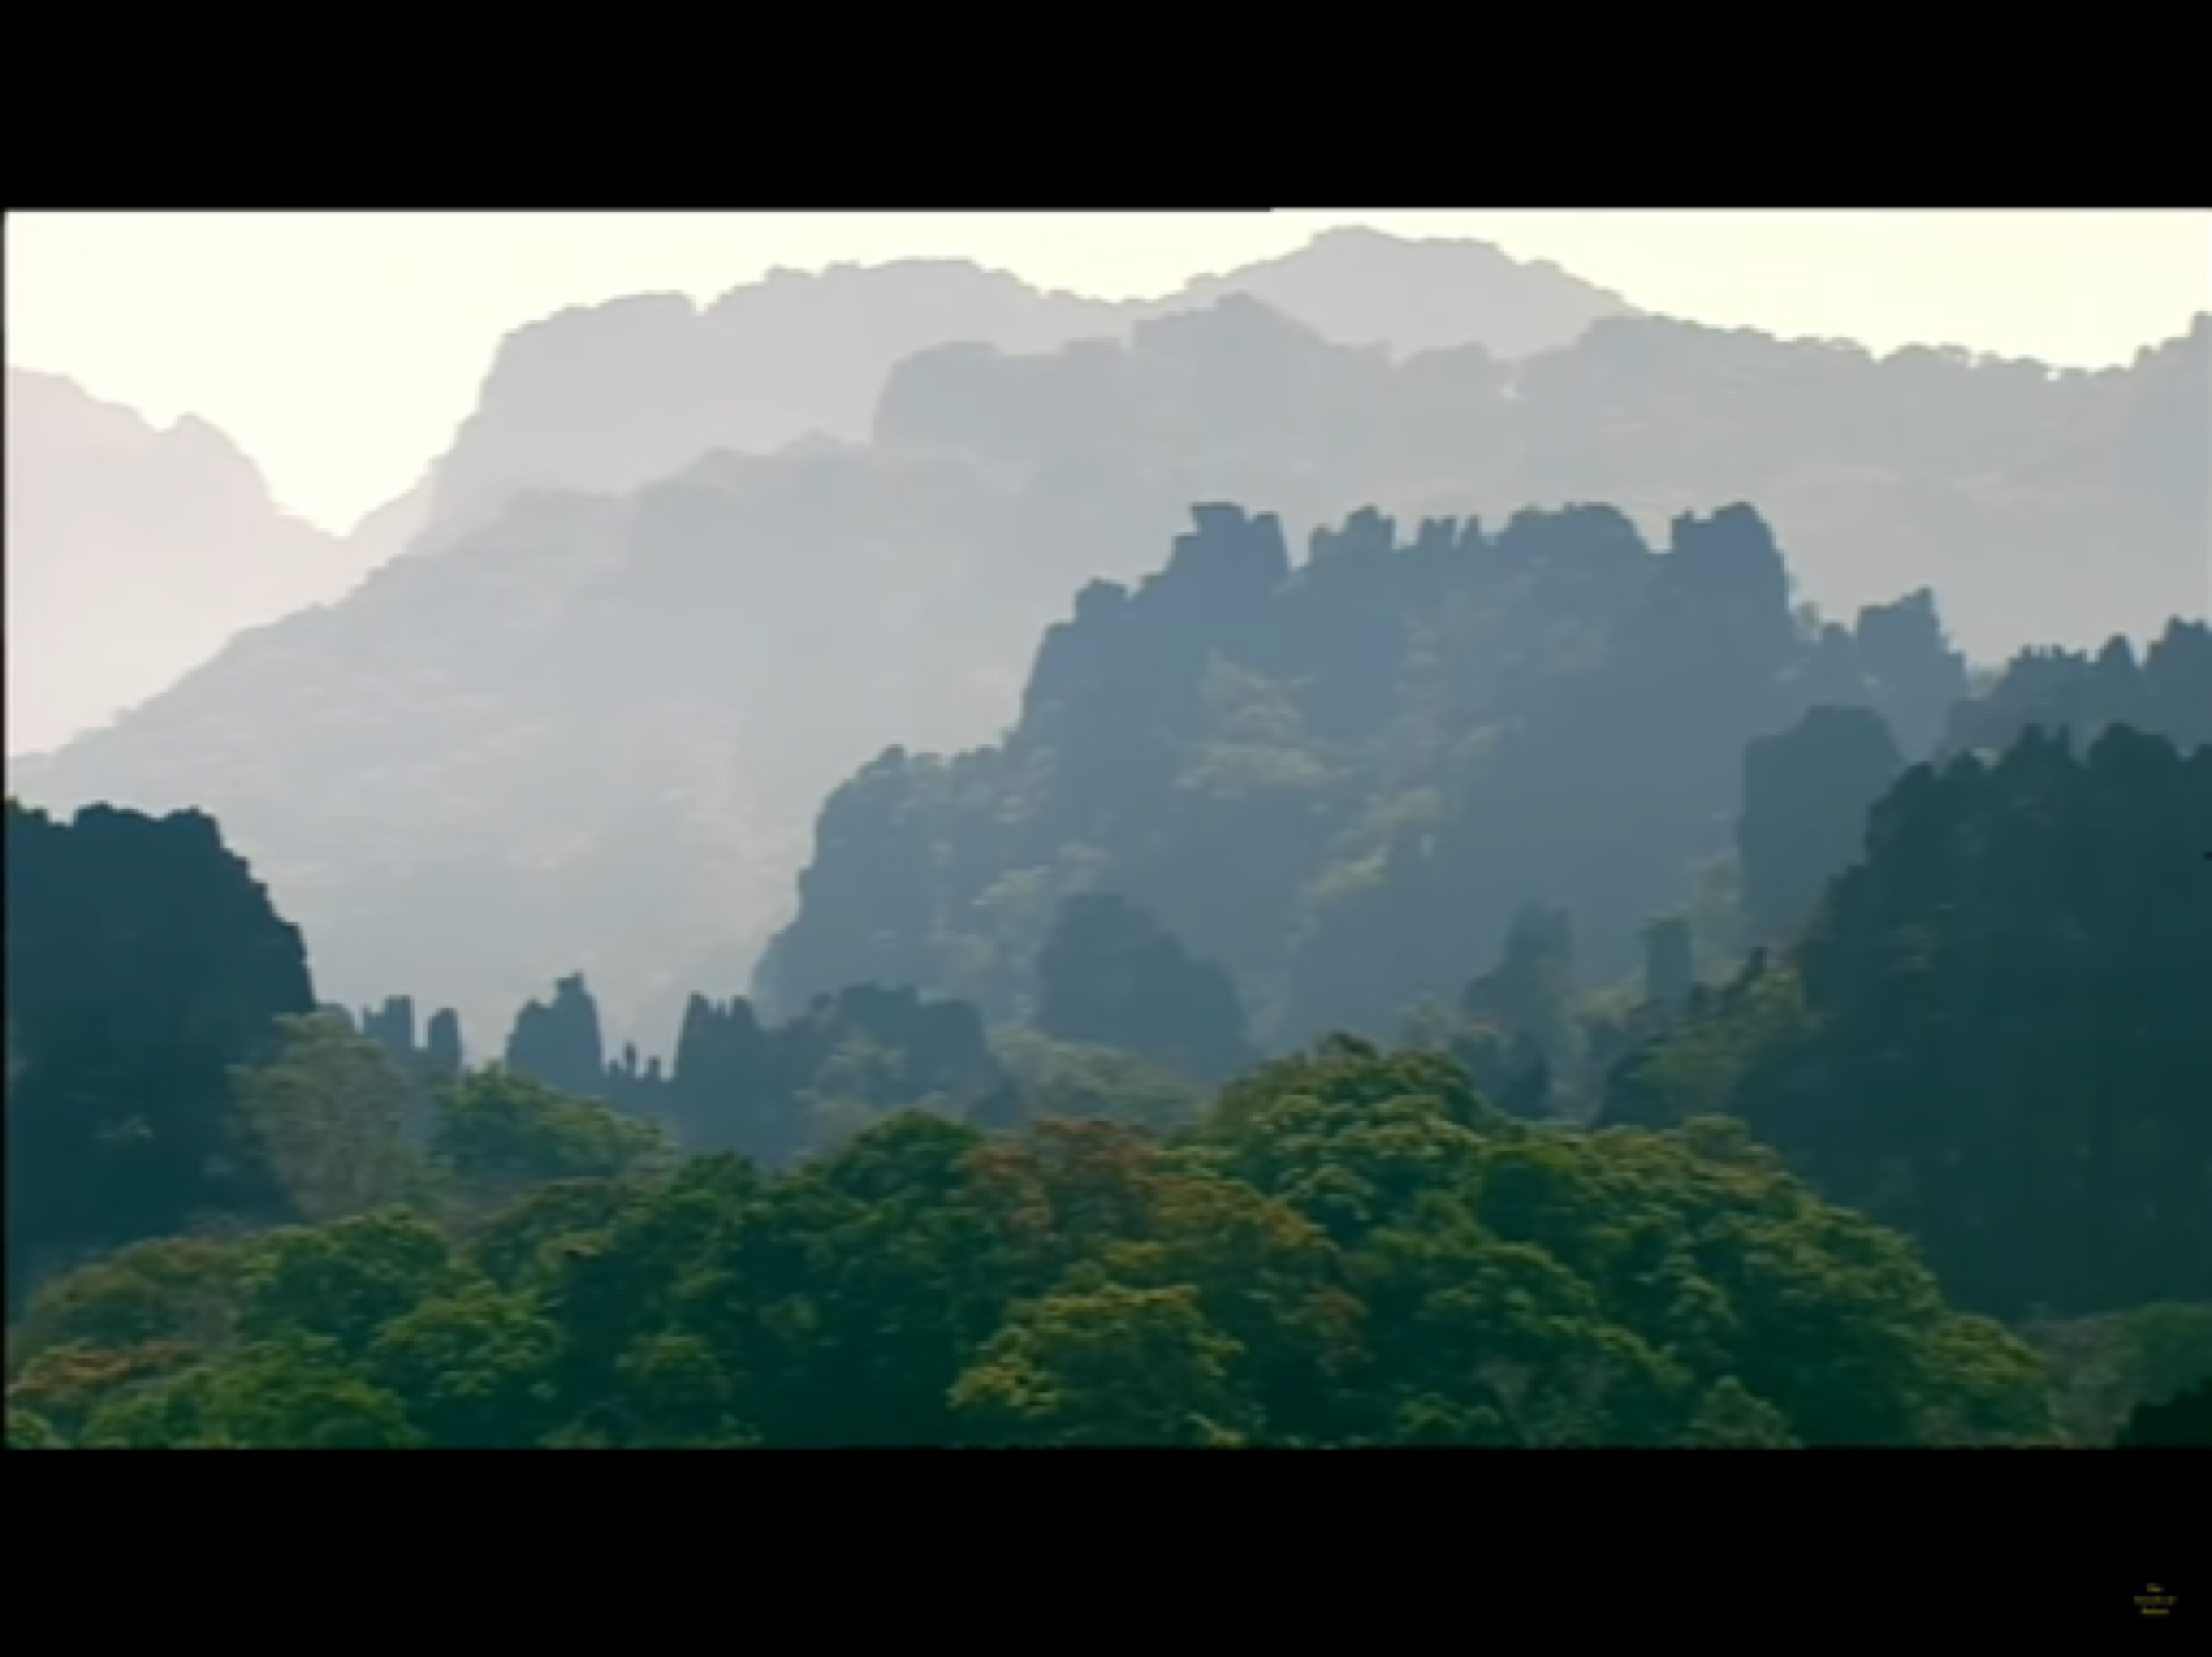
A teacher workshop:
The quiet ones of the Annamite mountains:
The Saola
Notes:
The Annamite mountains in Northern Laos are a Bio diversity hot spot..

Slide 2
Notes:
The mountains on the border of Northern Laos and Vietnam are an unspoilt wilderness, rugged and covered in evergreen forests, with little or no dry season. The mountain slopes are covered in tropical moist Montane cloud forests interspersed with Cypress-like conifers, called Vietnamese white pine, and the ground is filled with herbs, ferns and groundcovers.

Slide 3
Notes:
These mountains are home to over 300 species of birds in which over 50 are endangered. They are the habitat for many large mammals including the Asian Elephant, Giant Mumtjas, Gaur bos gaurus and the Saola plus over 100 species of mammals including bats and rodents. There are also over 50 species of reptiles and amphibians..
Globally threatened animals presiding in the area include the Pygmy loris, Douc Langur, Pale cheeked gibbon, Annamite striped rabbit, Annam flying frog, The marbled cat, The Big headed turtle, The Tawny fish owl and Hodgson’s frog mouth owl.

Slide 4
Notes:
The Saola is only found in one place in the world. It is believed to live in the forests in these remote mountains. Local villagers from the Annamite mountains report that Saola browses on leafy plants, fig leaves and fruits and stems along the rivers and animal trails.
The Saola are critically endangered. Loss of habitat is the main threat to their survival. They are elusive and have rarely been seen and it is unknown how many exist. There may be as few as 100 . The last sighting of a Saola was in 1992 when Forestry workers found the skull of a two horned animal in the mountain home of a local hunter.

Slide 5
Notes:
We created a mountain scene around the edges of a large cardboad box, as in the edges of a stage, then glued a large sheet of recycled white paper into the middle of the box, glueing it to all sides like a screen. This then made the structure for a Shadow theatre that we could use to create a narrative about the Saola and the endangered animals of the Annamite mountains.

Slide 6
Notes:
We positioned a light at the back of the cardboard box.
A torch light or a mobile phone light will work well.
We positioned this right at the back so that we created shadows on the screen at the front, from the black cardboard figures.

Slide 7
Notes:
We then began creating the forest scenery for the backdrop of the shadow theatre with trees/ grasses, mountains etc., out of black cardboard.

Slide 11
Notes:
We focused upon the endangered Saola.
The Saola’s name means Spindle horns in Vietnamese.
It is akin to an antelope, though it is closer to cattle in it’s genetic make up.
It’s spindle horns can be up to 50 cms high, twice the size of its head.
The Saola have silky short fur, a dark chestnut brown colour and distinctive markings above their eyes, their hooves and their chest.
Their tail is very short and is brown at the top and cream in the middle with a fluffy end. They are about 33 cm high and weigh between 79 to 90 kilograms.

Slide 12
Notes:
We then drew and cut out the Saola from black card as it was going to be the central character of the Shadow box narrative.

Slide 13
Notes:
We positioned the Saola into the scene behind the screen, turned on the light behind and knew immediately that we had the context for a shadow play called ‘The Quiet ones,’ telling the story of a day in the life of a Saola and its fellow endangered inhabitants of the Annamite mountain forest.
The shadows worked beautifully in he Shadow box theatre.

Slide 14
Notes:
We began making the shape of the endangered animals that shared the habitat with the Saola in the mountains, out of black card, ready for use in the narrative.

Slide 15
Notes:
We made the Tawny fish owl, which has large powerful and curved talons to eat the river fish, frogs and toads that it lives on.
The fish owl is not silent when it flies.
It’s wing beats can be heard as it flies through the forests before nightfall, seeking its prey.
They usually hunt by swooping down into the water to capture the fish.
They are highly solitary and territorial and nests include large holes in river banks and caves or the forks of large trees.
They lay their eggs where ever they are nesting.

Slide 16
Notes:
The slow loris has a round head, narrow snout, large eyes and a variety of distinctive coloration patterns that are species dependent. Their arms and legs are nearly equal in length and their torso is long and flexible allowing them to twist and extend in the branches of the forest trees.
They have a pincer like grip which enables them to grasp branches for long periods of time.
Their bite is toxic. and is used to deter predators.
They move slowly and deliberately making little or no noise. When threatened they stop and remain motionless. They are known to communicate by scent marking and the males are highly territorial. They are omnivores and eat small animals, forest fruits, seeds, tree gum and other vegetation.
They are highly endangered.

Slide 17
Notes:
The Annam flying frog is famous for its gliding acrobatics. Using the skin flaps between its toes, the flying frog glides from tree to tree in search of food, water and shelter.
It is recognized as one of the largest frog species.
It is a common tree frog in Vietnam BUT is facing habitat loss from deforestation and is classified as endangered in the Annamite mountains

Slide 18
Notes:
The Big headed turtle can readily climb over obstacles in and around rivers and fast streams, using its tail as a prop to extend the reach of its strong claws.
It also uses it’s beak to assist it with climbing… it does climb trees and bushes.
It is not a strong swimmer.
It eats snails and fish.
It cannot withdraw it’s head into it’s shell.
It is readily consumed in Asia and is found at the Village market stalls.
Hunters capture them on baited lines and they are rapidly disappearing.

Slide 20
Notes:
The marbled cat is a small wild cat where it inhabits the high mountain
forests. It is listed as near threatened.
It is similar in size to a domestic cat, but has rounded ears and a very long tail, that is as long as the cat’s body.
The colour of it’s long fur varies from brownish-grey to ochre brown and it is patterned with black stripes on his short and round head, neck and back. On its tail, limbs and underbelly it has solid spots and blotches on its flanks. It has large feet, unusually large canine teeth. They range in height from45 to 62cms and 35 to 55 cms long. Forest canopies provide the Marbled cat with its prey. It eats birds, squirrels, rodents and reptiles. Snaring poses its major threat and deforestation makes it very easy for the poaches to sight them.

Slide 21
Notes:
The Annamite striped rabbit has thick striped fur with a red rump
and has only recently been discovered in the Annamite mountains.
It eats weeds, grasses, wildflowers, figs, buds, bark and conifer needles and other green plants.
Threats to the species are hunting, either by snare, dogs or habitat loss which makes it very vulnerable to hunters.
Cultivation at lower altitudes and agriculture throughout, extensive road building which opens undisturbed areas to farmers and timber harvesters, mining and dams.
It is registered as endangered based upon it’s high level of danger of snaring.

Slide 22
Notes:
Hodgson’s frogmouth lives in the Annamite mountain forests. It is between 24-27 cms high and weighs approximately 50 grams. It’s brown and gray plumage resembles tree bark, with soft plumage and mottled feathers , that enables it to be camouflaged as if it was a broken branch.
It has a strong bill with facial bristles that detects insects and protect their eyes. Their large head has two large yellow rounded eyes that help them to navigate in the dark. It can be clearly identified by it’s call, which sounds like soft wheezy whistles to harsh tremulous rattles . It survives on a mainly insectivorous diet including moths, beetle and other large insects. It is declining because of habitat fragmentation and loss of lowland forest but is not yet considered vulnerable.

Slide 23
Notes:
The Large antlered Muntjac has rarely been seen in the Annamite mountains over the past 20 years.
Its shoulder height measures 26 inches and it weighs between 70 to 110 pounds.
It is highly endangered because of illegal wire-snare hunting.
They feed on trees and shrubs, shoots, herbs, berries, nuts and fungi .

Slide 24
Notes:
Then we began setting up the scenes of a narrative about the Saola and the endangered animals in the Annamite mountains in the shadow box theatre.

Slide 30
Notes:
We created a set of images of mountain climbers, photographers, hunters, explorers and villagers with snares and ropes who we then added to the shadow play story.

Slide 34
Notes:
We then set up the scene of the humans travelling through the forests looking for…
We created a narrative about the Quiet ones and the Saola of the Annamite mountains and used the shadow images to create the scenes.

